Slide 1
Onboarding [first month]
review

Slide 2
Мy opinion about colleagues

Slide 3
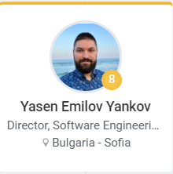
102 %
101 %
101 %
101 %
101 %
101 %
101 %

Slide 4
Аbout myself...

Slide 5
40 %

Slide 6
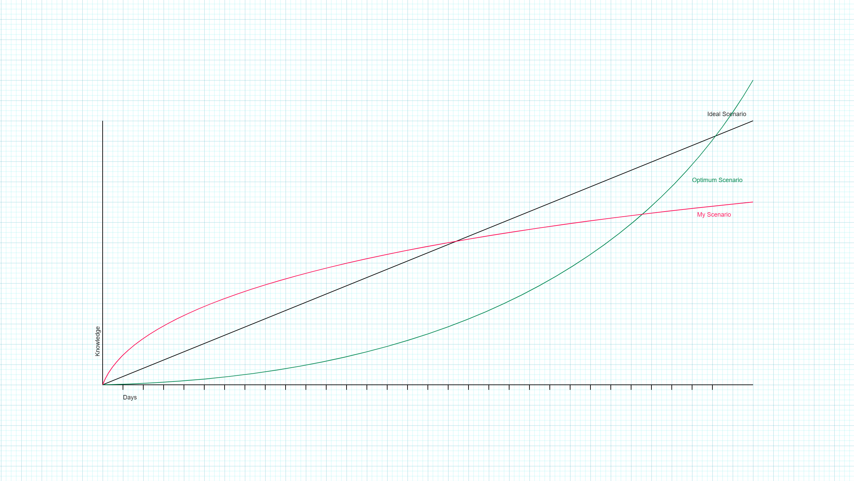

Slide 7
Reasons:
Health issues
University problems
Other

Slide 8
…

